Slide 1
Microservices Architecture: Data Management Issues
Mid-term Progress Evaluation
Asim Riaz
1732102
Supervisor:
Dr. Adeel Ansari

Slide 2
Contents
Introduction
Microservice Architecture
Motivating Factors
Microservices Data Management Issues
Macro
Micro
Related Work
References
Q&A

Slide 3
Introduction
Microservices have become a popular architectural style for data driven applications, given their ability to functionally decompose an application into small and autonomous services to achieve scalability, strong isolation, and specialization of database systems to the workloads and data formats of each service. [1,2]

Slide 4
Introduction
Each microservice may also manage its own database that is suitable to the data formats and workloads of the microservice. This flexibility is often associated with the polyglot persistence principle, where different categories of database systems (e.g., loosely structured NoSQL vs. relational) service separate microservices. [9]

Slide 5
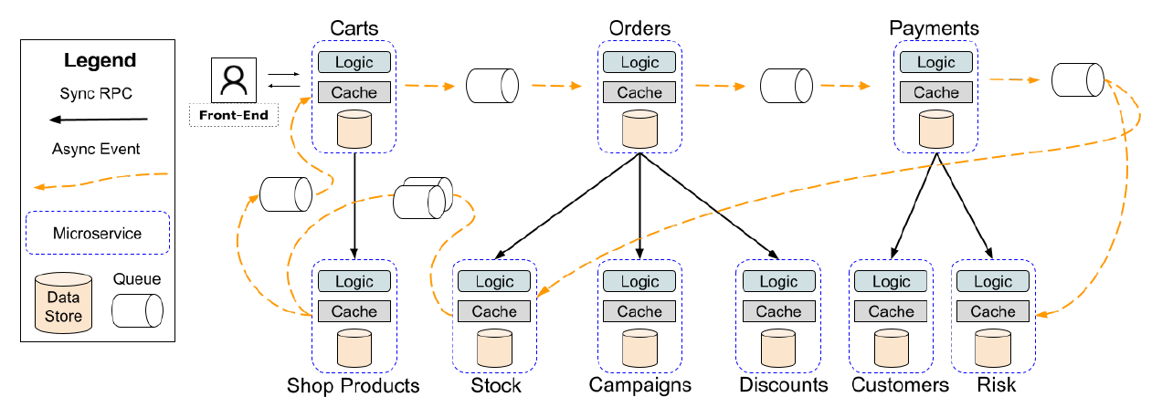
Microservice Architecture

Slide 6
Motivating Factors
Following are the primary reasons behind the adoption of microservices for data management.
Functional Decomposition
Decentralized Data management
Event-Driven Microservices
Fault Isolation
Schema Evolution

Slide 7
Microservices Data Management Macro Issues
Cross Microservice Validations [3,4]
Implicit Cross Microservice Associations [5]
Cross Microservice Queries [6, 7]
Feral ordering[1, 16]

Slide 8
Cross Microservice Validations

Slide 9
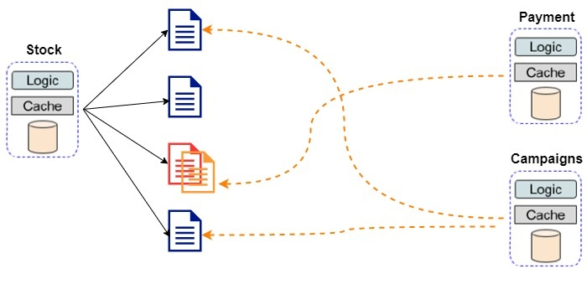
Implicit Cross Microservice Associations

Slide 10
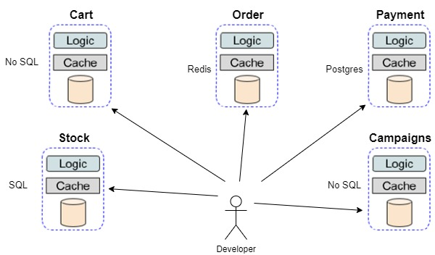
Cross Microservice Queries

Slide 11
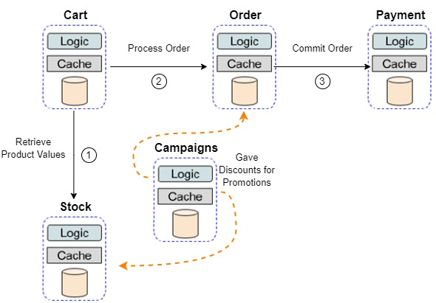
Feral Ordering

Slide 12
Microservices Data Management Micro Issues
Constraint enforcement and schema evolution
Eventual consistency
Ensuring consistency between heterogeneous database systems.

Slide 13
Related Work
Towards Microservice-oriented Database Systems [1]
A Distributed Database System for Event-based Microservices [12]
HawkEDA - A Tool for Quantifying Data Integrity Violations in Event-driven Microservices [13]
Enforcing Consistency in Microservice Architectures through Event-based Constraints [14]

Slide 14
References
Laigner, R., Zhou, Y., Salles, M.A.V., Liu, Y. and Kalinowski, M., 2021. Data Management in Microservices: State of the Practice, Challenges, and Research Directions. arXiv preprint arXiv:2103.00170.
Baškarada, S., Nguyen, V. and Koronios, A., 2018. Architecting microservices: Practical opportunities and challenges. Journal of Computer Information Systems.
Nguyen, P.H., Song, H., Chauvel, F., Muller, R., Boyar, S. and Levin, E., 2019, August. Using microservices for non-intrusive customization of multi-tenant SaaS. In Proceedings of the 2019 27th ACM Joint Meeting on European Software Engineering Conference and Symposium on the Foundations of Software Engineering (pp. 905-915).
Genfer, P. and Zdun, U., 2021, September. Identifying Domain-Based Cyclic Dependencies in Microservice APIs Using Source Code Detectors. In European Conference on Software Architecture (pp. 207-222). Springer, Cham.
Mosser, S., Caissy, J.P., Juroszek, F., Vouters, F. and Moha, N., 2020, December. Charting microservices to support services’ developers: The anaximander approach. In International Conference on Service-Oriented Computing (pp. 36-44). Springer, Cham.
Azevedo, L.G., Ferreira, R.D.S., Silva, V.T.D., de Bayser, M., Soares, E.F.D.S. and Thiago, R.M., 2019, September. Geological data access on a polyglot database using a service architecture. In Proceedings of the XIII Brazilian Symposium on Software Components, Architectures, and Reuse (pp. 103-112).
Krylovskiy, A., Jahn, M. and Patti, E., 2015, August. Designing a smart city internet of things platform with microservice architecture. In 2015 3rd International Conference on Future Internet of Things and Cloud (pp. 25-30). IEEE.
Peter Bailis and Ali Ghodsi. 2013. Eventual Consistency Today: Limitations, Extensions, and Beyond. Queue 11, 3 (March 2013), 20–32. https://doi.org/10.1145/2460276.2462076

Slide 15
References
Shadija, D., Rezai, M. and Hill, R., 2017, September. Towards an understanding of microservices. In 2017 23rd International Conference on Automation and Computing (ICAC) (pp. 1-6). IEEE.
Ntentos, E., Zdun, U., Plakidas, K., Schall, D., Li, F. and Meixner, S., 2019, September. Supporting architectural decision making on data management in microservice architectures. In European Conference on Software Architecture (pp. 20-36). Springer, Cham.
Laigner, R., Kalinowski, M., Diniz, P., Barros, L., Cassino, C., Lemos, M., Arruda, D., Lifschitz, S. and Zhou, Y., 2020, August. From a monolithic big data system to a microservices event-driven architecture. In 2020 46th Euromicro Conference on Software Engineering and Advanced Applications (SEAA) (pp. 213-220). IEEE.
Laigner, R., Zhou, Y. and Salles, M.A.V., 2021, June. A distributed database system for event-based microservices. In Proceedings of the 15th ACM International Conference on Distributed and Event-based Systems (pp. 25-30).Hinsen, K., 2007. Parallel scripting with Python. Computing in Science and Engineering, 9(6), p.82.
Das, P., Laigner, R. and Zhou, Y., 2021, June. HawkEDA: a tool for quantifying data integrity violations in event-driven microservices. In Proceedings of the 15th ACM International Conference on Distributed and Event-based Systems (pp. 176-179).
Lesniak, A., Laigner, R. and Zhou, Y., 2021, June. Enforcing consistency in microservice architectures through event-based constraints. In Proceedings of the 15th ACM International Conference on Distributed and Event-based Systems (pp. 180-183).
Carrasco, A., Bladel, B.V. and Demeyer, S., 2018, September. Migrating towards microservices: migration and architecture smells. In Proceedings of the 2nd International Workshop on Refactoring (pp. 1-6).
.NET Application Architecture Reference Apps. [n.d.]. eShopOnContainers. https://github.com/dotnet-architecture/eShopOnContainers

Slide 16
Question & Answer Session
Thank you

